Slide 1
COST OPTIMIZATION
&
WEBSITE PERFORMANCE
Name: Thu Thuy
Email: thuthuy.working26@gmail.com

Slide 2
REQUIREMENT
COST OPTIMIZATION
For the next quarter, your marketing department has a budget of $60,000 to spend on online campaigns.
How would you allocate it between SMS and Email?

Slide 3
BUSINESS UNDERSTANDING
A company produces a new generation of electric men razor. Last month the company registered an e-commerce site to sell its product online instead of the traditional supermarket channel. During the last month, it piloted advertising on 2 channels: SMS and Email
Customer journey
(Last step, channel)
Customer demography
(Age range, #Customer, $Order value, coupon)
Net profit
Net profit = order value - razor cost - channel cost
Channel cost
Coupon value
Razor cost

Slide 4
PLANNING
In the next campaign, the company has budget $60000.
A potential customer pool by age group and channel cost to send message listed below:
Age group | Pool size
18 – 30 | 300,000
31 - 45 | 350,000
46 – 60 | 500,000
60+ | 200,000
Channel | Cost
Email | 0.075
SMS | 0.05
1. The number of message sending
- To increase awareness, I plan to send messages to all customers of last campaign.
- To acquire more customer and optimize cost, I plan to send additional messages to potential pool based on profit rate of last campaign to each age group
2. The total cost for the next campaign (I do not include production cost in this budget)
Total cost = Sending cost + coupon value
- Allocate coupons as last campaign to convert to at least the next step

Slide 5
APRIL CAMPAIGN RECAP
3,135
Product sold
115,864
Order value
1,862
No. coupon
4,110
Coupon value
18,412
Sending costs
74,842
Total costs
41,022
Total profits
Age range | Channel | No. msg | % sent msg/channel | No. purchased msg | % Purchased msg | $ Profit | % Profit/msg
18-30 | Email | 46,660 | 36.2% | 273 | 0.59% | 4,408.5 | 9.4%
31-45 | Email | 55,880 | 54.9% | 558 | 1.00% | 12,497 | 22.4%
46-60 | Email | 23,001 | 30.5% | 115 | 0.50% | 1,418.9 | 6.2%
60+ | Email | 10,948 | 36.9% | 2 | 0.02% | -751.1 | -6.9%
18-30 | SMS | 55,447 | 63.8% | 426 | 0.77% | 11,991.7 | 21.6%
31-45 | SMS | 67,020 | 45.1% | 185 | 0.28% | 3,507 | 5.2%
46-60 | SMS | 27,892 | 69.5% | 297 | 1.06% | 8,417.4 | 30.2%
60+ | SMS | 13,152 | 63.1% | 6 | 0.05% | -467.6 | -3.6%
Grand Total |  | 300,000 | 100% | 1,862 | 0.53% | 41,022 | 10.6%

Slide 6
KEY INSIGHTS
1. Channel Effectiveness: SMS is more effective than email in terms of both the percentage of messages sent that result in purchases and the percentage of profit per message.
2. Age Group Response: The 46-60 age group has the highest percentage of purchased messages for both email and SMS channels, indicating that this age group may be more responsive to marketing messages.
3. Profitability: The 31-45 age group generates the highest profit for both email and SMS channels, with the SMS channel showing exceptionally high profitability for this age group.
4. Negative Profit: The 60+ age group has negative profits for email and SMS channels, indicating that marketing to this age group may be less effective or profitable.
5. Overall Trends: Across all age groups, the SMS channel tends to have higher percentages of purchased messages and higher profitability per message than the email channel.
These insights suggest that targeting the 31-45 age group with SMS marketing could be a profitable strategy, while marketing to the 60+ age group may require further refinement or a different approach to be successful.

Slide 7
BUDGETING FOR SENDING MESSAGE
Age range | Channel | No. Message | Next message | Total message | $ Total cost
18-30 | Email | 46,660 | 7,560 | 54,220 | 4,067
31-45 | Email | 55,880 | 40,425 | 96,305 | 7,223
46-60 | Email | 23,001 | 1,200 | 24,201 | 1,815
60+ | Email | 10,948 | 0 | 10948 | 821
18-30 | SMS | 55,447 | 38,400 | 93,847 | 4,692
31-45 | SMS | 67,020 | 9,450 | 76,470 | 3,823
46-60 | SMS | 27,892 | 19,600 | 47,492 | 2,375
60+ | SMS | 13,152 | 0 | 13152 | 658
Grand Total |  | 300,000 | 116,635 | 416,635 | 25,473
As a plan, I will send messages to all customers of last campaign. To acquire more customers, I send additional messages to potential pool based on profit rate of last campaign to each age group.
For age group 60+, profit rate is negative, therefore, I will send no additional messages to this group.
Total budgeted cost for sending message next campaign is $25,473. The remaining budget is prepared for coupon value that customers purchase our product and use coupons.

Slide 8
BUDGETING FOR COUPON VALUE
Age range | Channel | Coupon | % Percent | $ Cost
18-30 | Email | 2 | 0.51 | 498
18-30 | Email | 4 | 0.79 | 1,542
18-30 | Email | 6 | 0.55 | 1,610
31-45 | Email | 2 | 1.07 | 1,855
31-45 | Email | 4 | 0.90 | 3,120
31-45 | Email | 6 | 0.87 | 4,524
46-60 | Email | 2 | 0.46 | 201
46-60 | Email | 4 | 0.35 | 305
46-60 | Email | 6 | 0.91 | 1,189
60+ | Email | 4 | 0.04 | 14
60+ | Email | 6 | 0.06 | 33
Age range | Channel | Coupon | % Percent | $ Cost
18-30 | SMS | 2 | 0.72 | 1,216
18-30 | SMS | 4 | 0.80 | 2,703
18-30 | SMS | 6 | 0.91 | 4,612
31-45 | SMS | 2 | 0.26 | 358
31-45 | SMS | 4 | 0.28 | 770
31-45 | SMS | 6 | 0.34 | 1,404
46-60 | SMS | 2 | 0.72 | 616
46-60 | SMS | 4 | 1.53 | 2,616
46-60 | SMS | 6 | 1.67 | 4,283
60+ | SMS | 2 | 0.04 | 9
60+ | SMS | 4 | 0.09 | 39
% percent: No. purchased customers/Total purchased customer
Total coupon value = $33,517
Total cost = sending cost + coupon value = 58,990 (under budget)

Slide 9
REQUIREMENT
WEBSITE PERFORMANCE
Improve the website’s performance to maximize net profit?

Slide 10
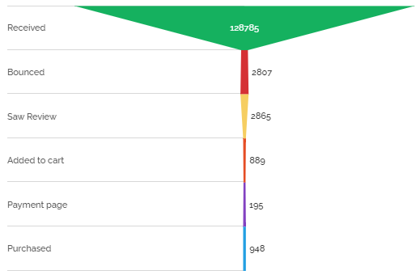
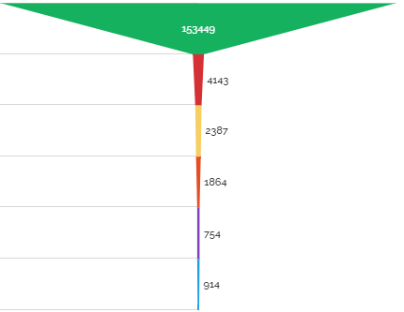
WEB PERFORMANCE
Customer journey
Email
SMS
Customer exploration
Bounced: 2.7%
Bounced: 2.28%
Saw review: 2.22%
Saw review: 1.56%
Add to cart: 0.69%
Add to cart : 1.21%
Payment flow
Payment page: 0.15%
Payment page: 0.49%
Purchased: 0.74%
Purchased: 0.6%

Slide 11
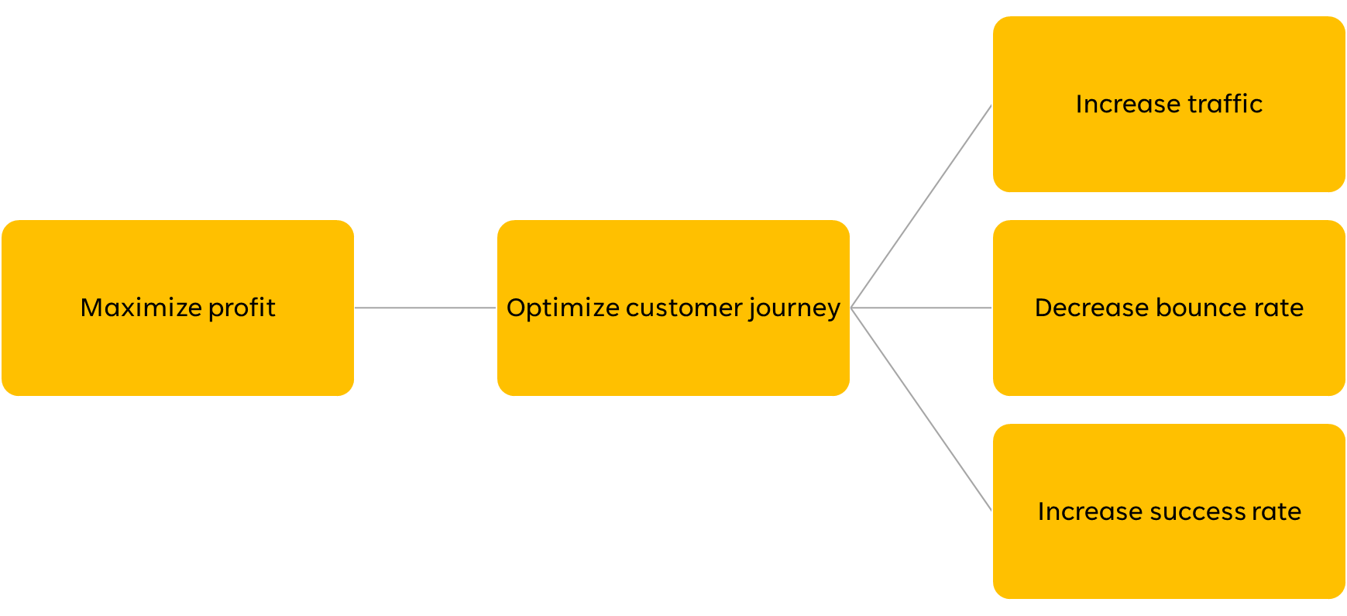
WEB PERFORMANCE
Profit maximization model – website performance perspective

Slide 12
KEY METRICS OF APRIL CAMPAIGN
Bounce rate
= Total one-page visits / Total entrance visits
Cart Abandonment rate
= Transaction completed/ Shopping cart initiated
Bounce rate
Age range | Email | SMS
18-30 | 37.87% | 35.25%
31-45 | 35.31% | 47.90%
46-60 | 38.99% | 42.33%
60+ | 31.41% | 32.72%
Cart Abandonment Rate
Age range | Email | SMS
18-30 | 45.27% | 30.36%
31-45 | 55.63% | 15.49%
46-60 | 30.42% | 35.32%
60+ | 4.17% | 6.38%
Consistent Channel Trends: SMS generally has higher bounce rates across age groups than Email, indicating that Email may be more effective in maintaining user engagement.
Targeting Consideration: For the 31-45 and 46-60 age group, which show higher bounce rates for email, focusing on SMS marketing could improve engagement and reduce bounce rates.
Age Group Engagement: The 60+ age group exhibits the lowest bounce rates for both email and SMS, suggesting higher engagement levels with marketing content in this demographic.
Consistent Channel Performance: SMS generally has lower cart abandonment rates compared to email.
Conversion and Engagement: Lower cart abandonment rates in SMS, especially in the 31-45 age group, could be linked to higher conversion rates and engagement levels in this demographic
Age Group Behavior: The 60+ age group shows relatively low cart abandonment rates for both email and SMS, suggesting a higher likelihood of completing purchases once items are added to the cart.

Slide 13
KEY METRICS OF APRIL CAMPAIGN
Bounce rate
= Total one-page visits / Total entrance visits
Cart Abandonment rate
= Transaction completed/ Shopping cart initiated
Bounce rate
Age range | Email | SMS
18-30 | 37.87% | 35.25%
31-45 | 35.31% | 47.90%
46-60 | 38.99% | 42.33%
60+ | 31.41% | 32.72%
Cart Abandonment Rate
Age range | Email | SMS
18-30 | 45.27% | 30.36%
31-45 | 55.63% | 15.49%
46-60 | 30.42% | 35.32%
60+ | 4.17% | 6.38%
Consistent Channel Trends: SMS generally has higher bounce rates across age groups than Email, indicating that Email may be more effective in maintaining user engagement.
Targeting Consideration: For the 31-45 and 46-60 age group, which show higher bounce rates for email, focusing on SMS marketing could improve engagement and reduce bounce rates.
Age Group Engagement: The 60+ age group exhibits the lowest bounce rates for both email and SMS, suggesting higher engagement levels with marketing content in this demographic.
Consistent Channel Performance: SMS generally has lower cart abandonment rates compared to email.
Conversion and Engagement: Lower cart abandonment rates in SMS, especially in the 31-45 age group, could be linked to higher conversion rates and engagement levels in this demographic
Age Group Behavior: The 60+ age group shows relatively low cart abandonment rates for both email and SMS, suggesting a higher likelihood of completing purchases once items are added to the cart.

Slide 14
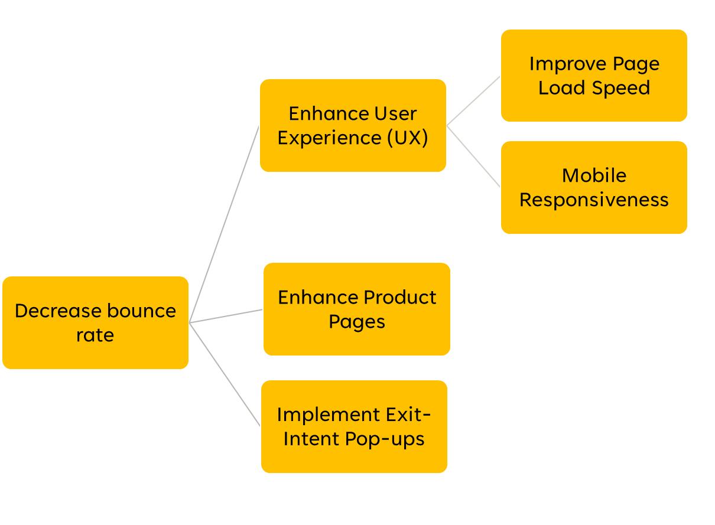
DECREASING BOUNCE RATE SUGGESTIONS
Optimize images, use browser caching, and minimize redirects to speed up your website.
Provide a seamless experience across all devices. Mobile optimization is crucial as more users shop on smartphones and tablets, esp ecommerce
Create informative and visually appealing product pages with high-quality images, detailed descriptions, and customer reviews to help users make informed purchasing decisions.
Use exit-intent pop-ups to offer discounts or promotions to visitors who are about to leave your site. This can help retain visitors and encourage them to make a purchase.

Slide 15
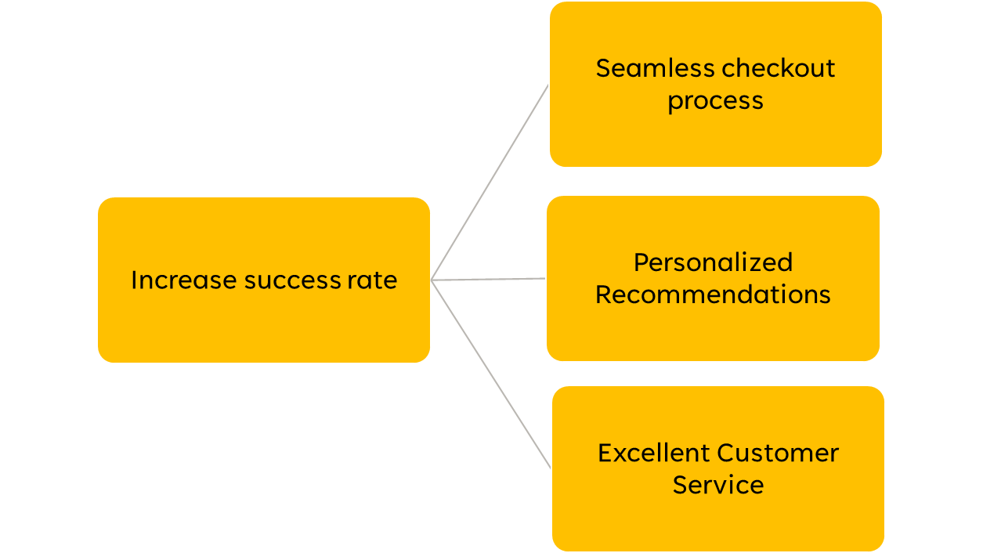
INCREASE SUCCESS RATE SUGGESTIONS
Offer customers checkout options, provide clear instructions, and minimize the number of steps required to complete a purchase.
Use data analytics and machine learning algorithms to offer personalized product recommendations to customers based on their browsing and purchase history.
Offer multiple channels for customer support, such as live chat, email, and phone support, and ensure that customer queries are addressed promptly and effectively.

Slide 16
THANK YOU
Name: Thu Thuy
LinkedIN: Thủy Nguyễn
Email: thuthuy.working26@gmail.com
Github: Joyeength

